Slide 1
ME 233 Advanced Control II
Lecture 20
Least Squares
Parameter Estimation
TexPoint fonts used in EMF.
Read the TexPoint manual before you delete this box.: AAA

Slide 2
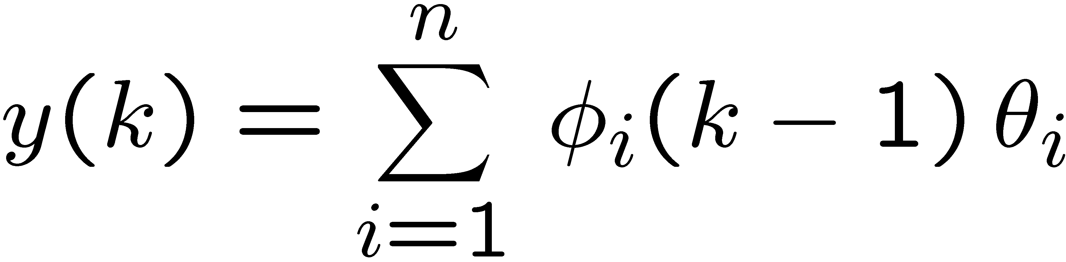

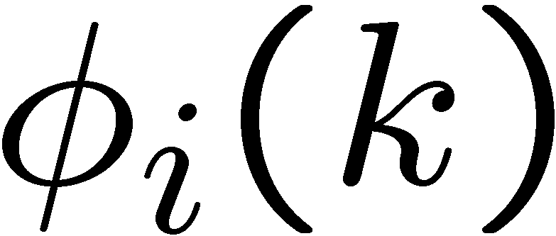

Least Squares Estimation
Model
Where
observed output
known and measurable function
unknown but constant parameter

Slide 3
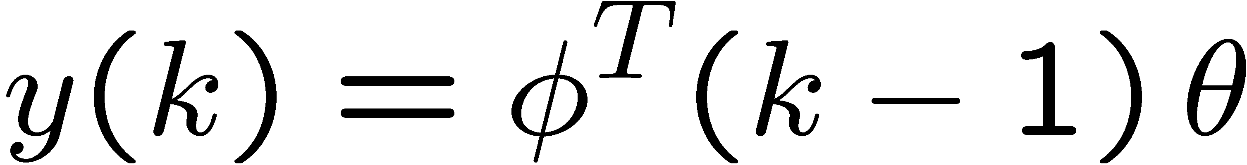
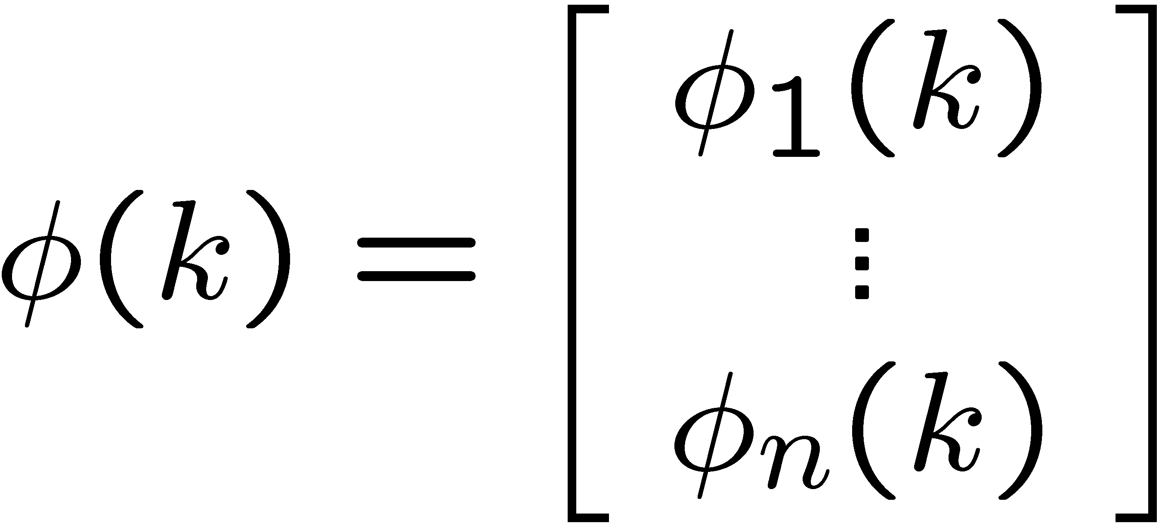
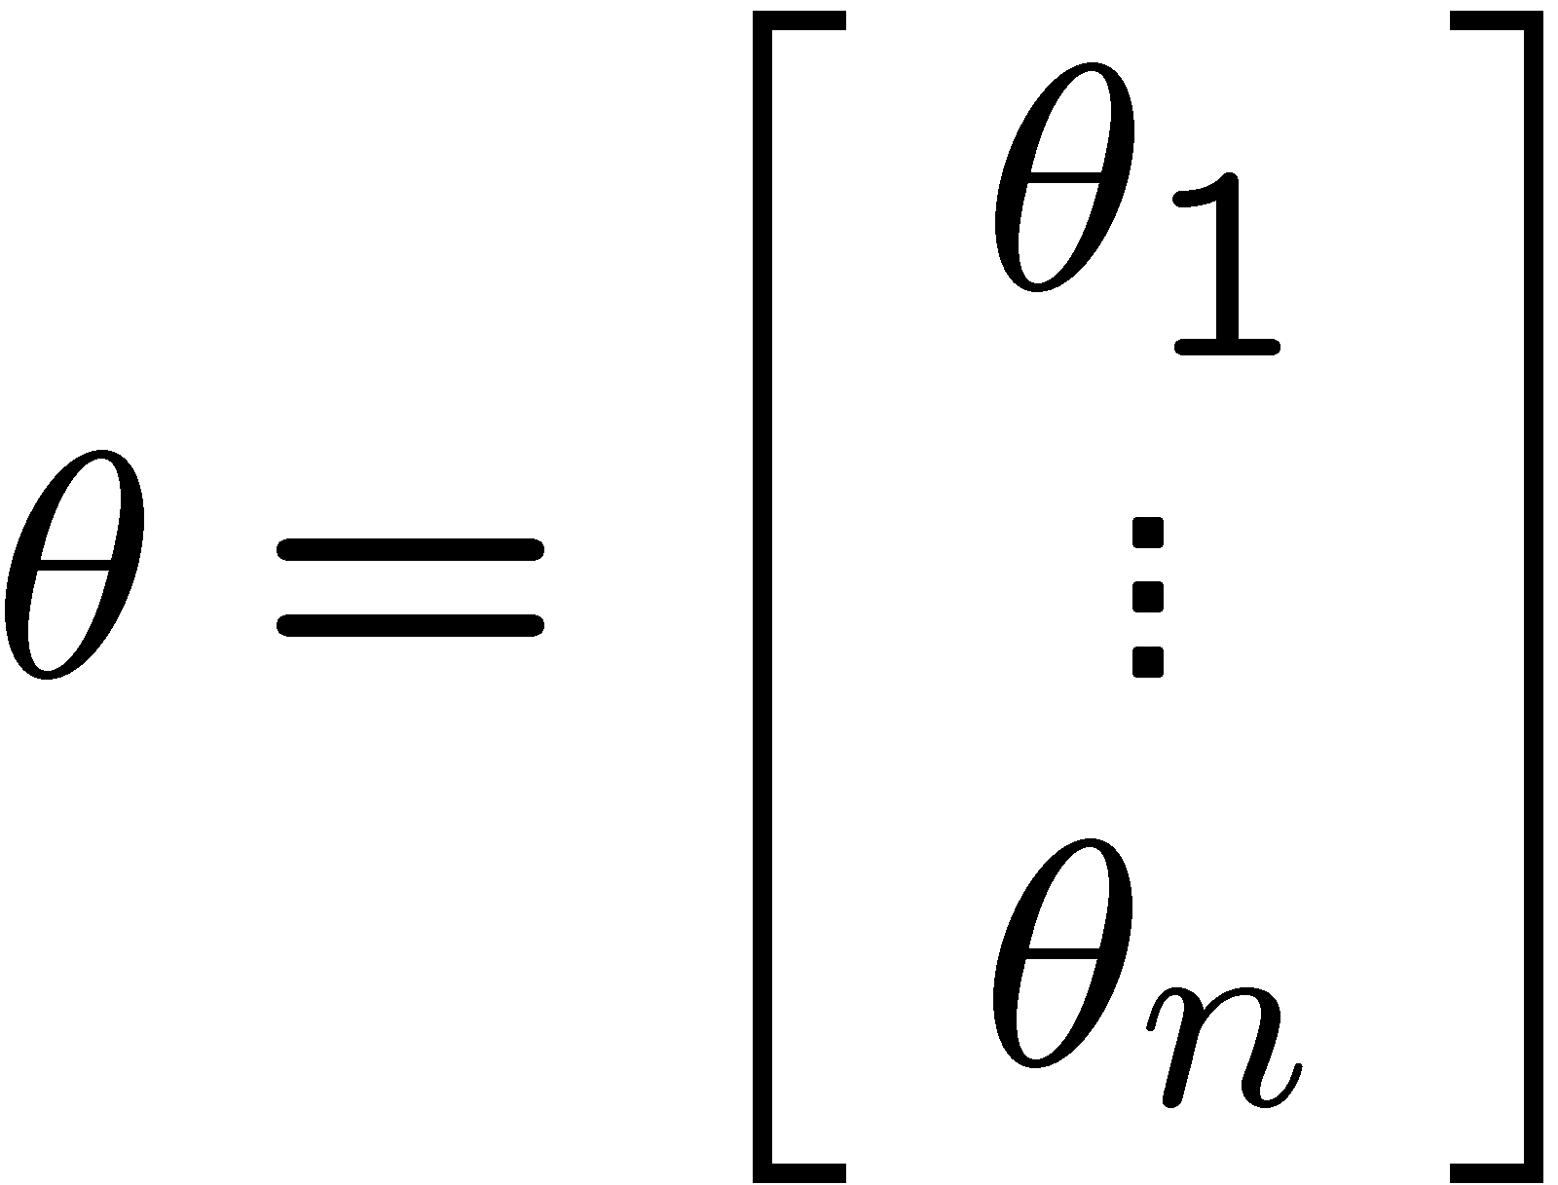


Least Squares Estimation
Model
Where
measured output

Slide 4
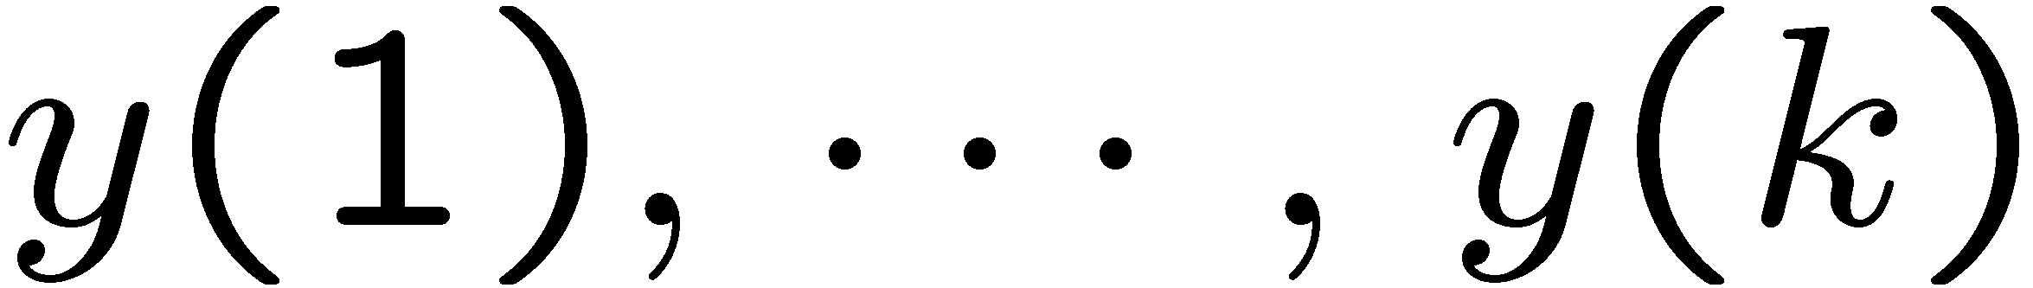

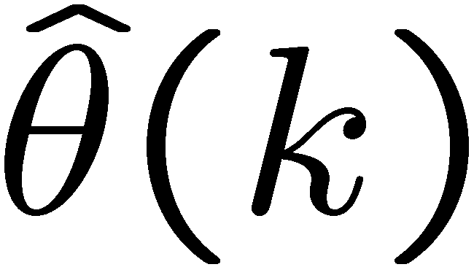
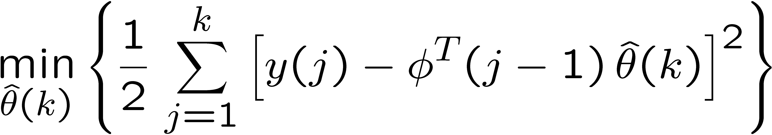
Batch Least Squares Estimation
Assume that we have collected k data sets:
collected data
We want to find the parameter estimate at instant k:
that best fits all collected data in the least squares sense:
kept constant in the summation

Slide 5
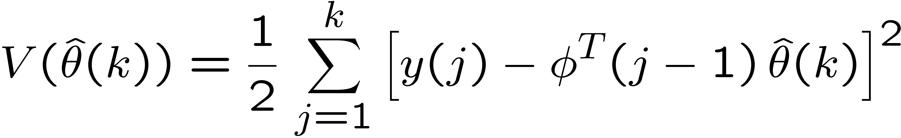
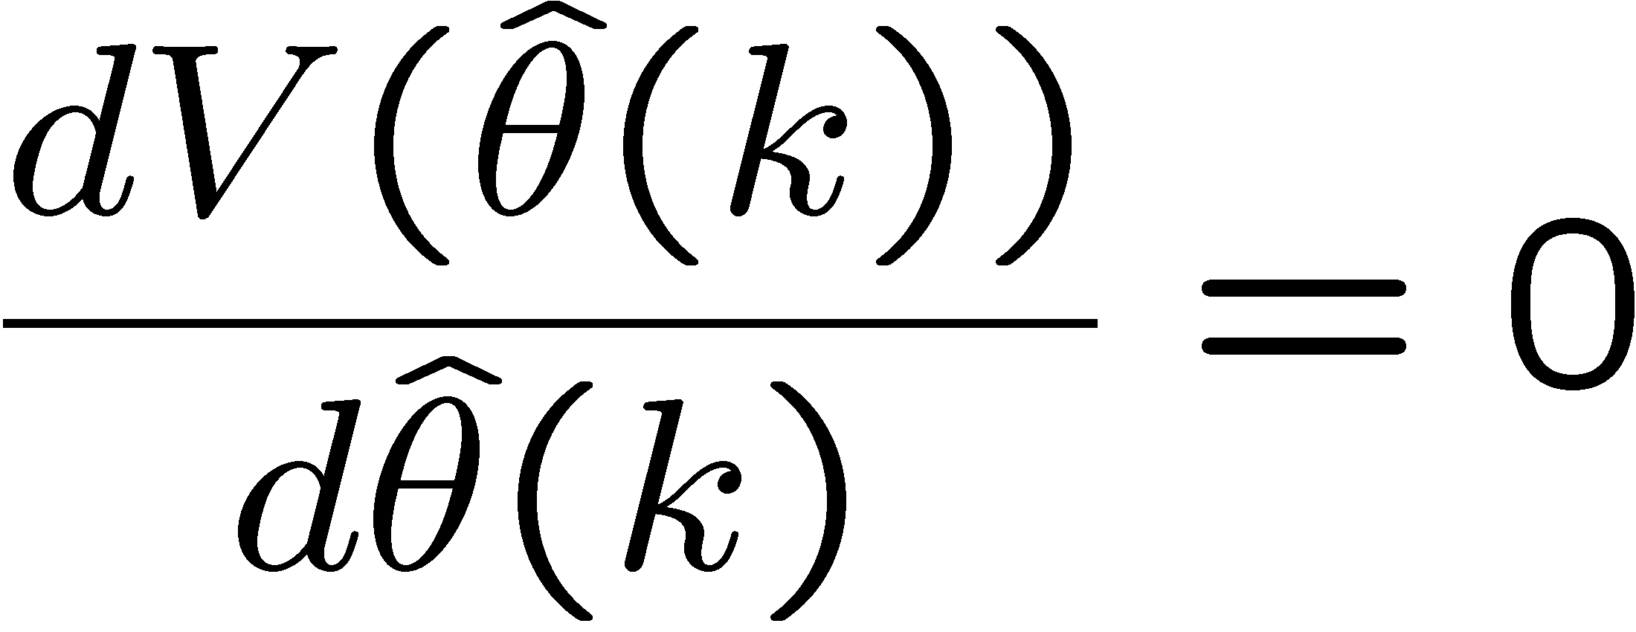
Batch Least Squares Estimation
Defining the cost functional
is obtained by solving

Slide 6
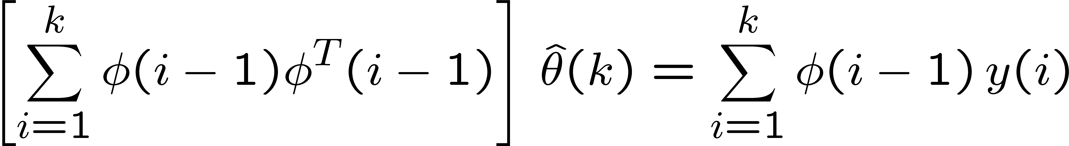


Batch Least Squares Solution
The least squares parameter estimate which solves
Satisfies the normal equation:

Slide 7
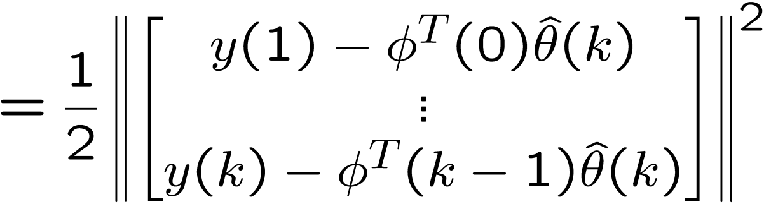
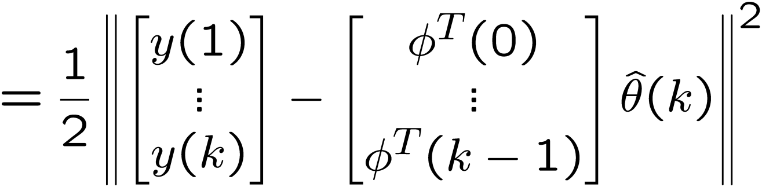


Normal Equation Derivation

Slide 8
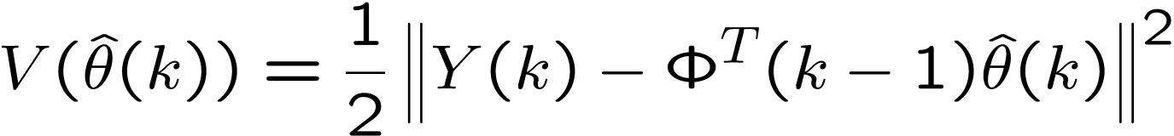
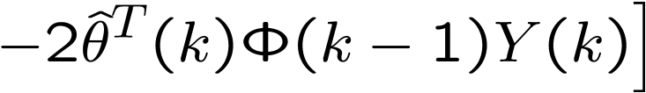

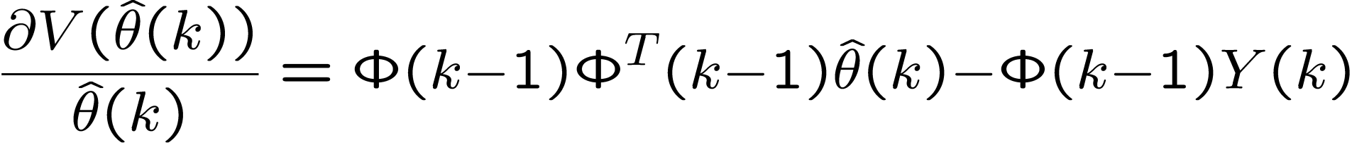
Normal Equation Derivation
Taking the partial derivative with respect to
For optimality, we therefore need

Slide 9

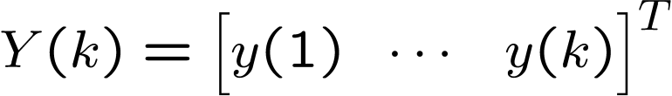
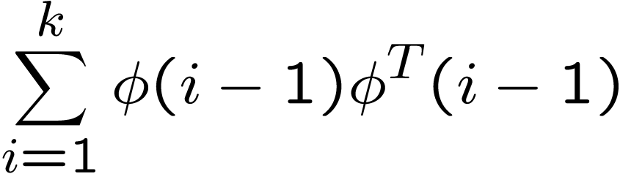
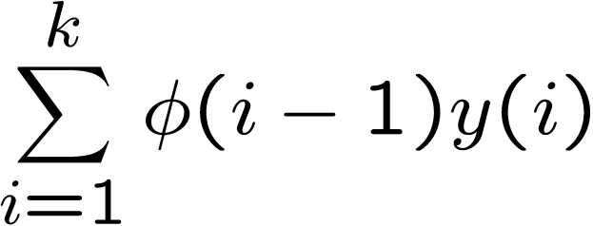
Normal Equation Derivation
For optimality, we need
Therefore, we need

Slide 10
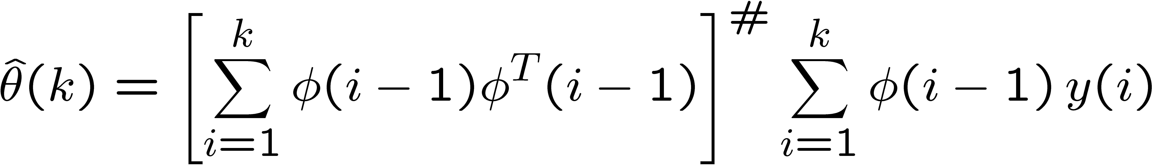
Batch Least Squares Estimation
The solution of the normal equation
Is given by:
Pseudoinverse

Slide 11
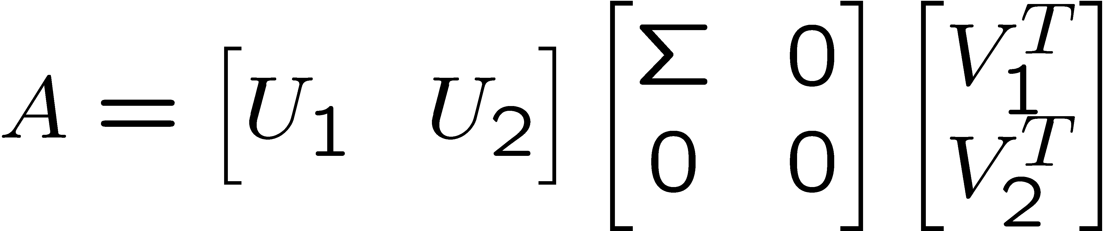
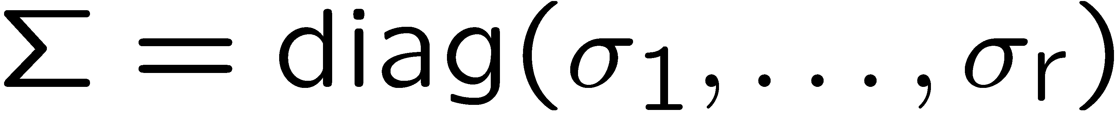
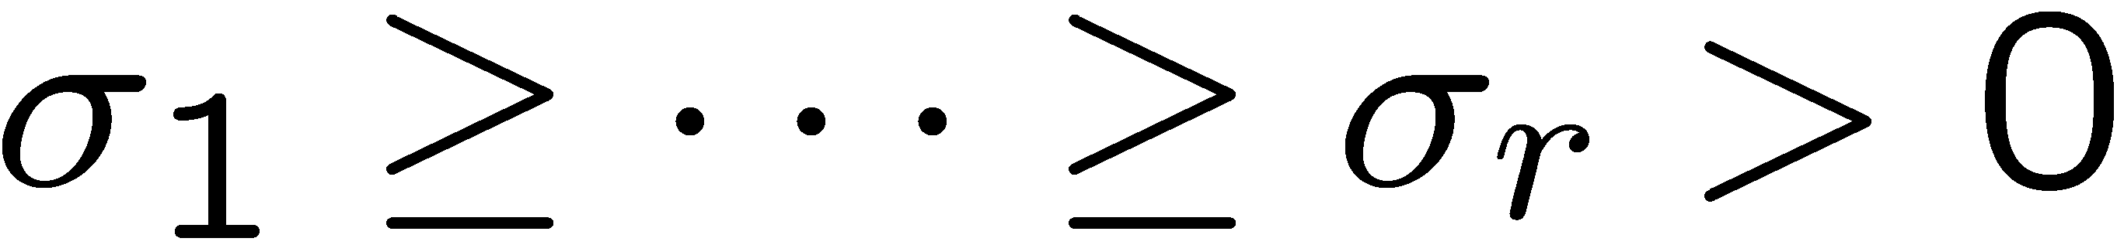
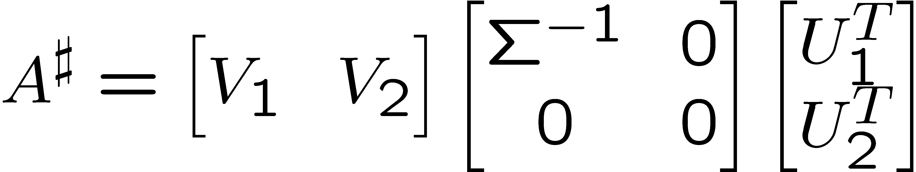
Moore-Penrose pseudoinverse
Let A have the singular value decomposition
Then the Moore-Penrose pseudoinverse of A is
orthogonal matrices
In MATLAB: pinv(A)

Slide 12
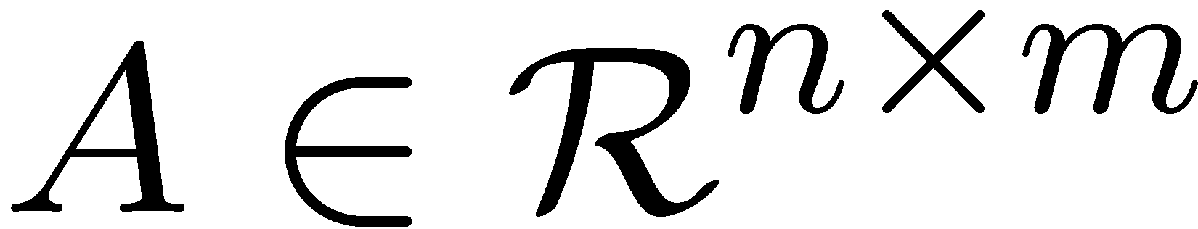









Moore-Penrose pseudoinverse
Let and be its Moore-Penrose pseudoinverse
Then has the dimension of and satisfies:
and
are Hermitian
In this case, since

Slide 13
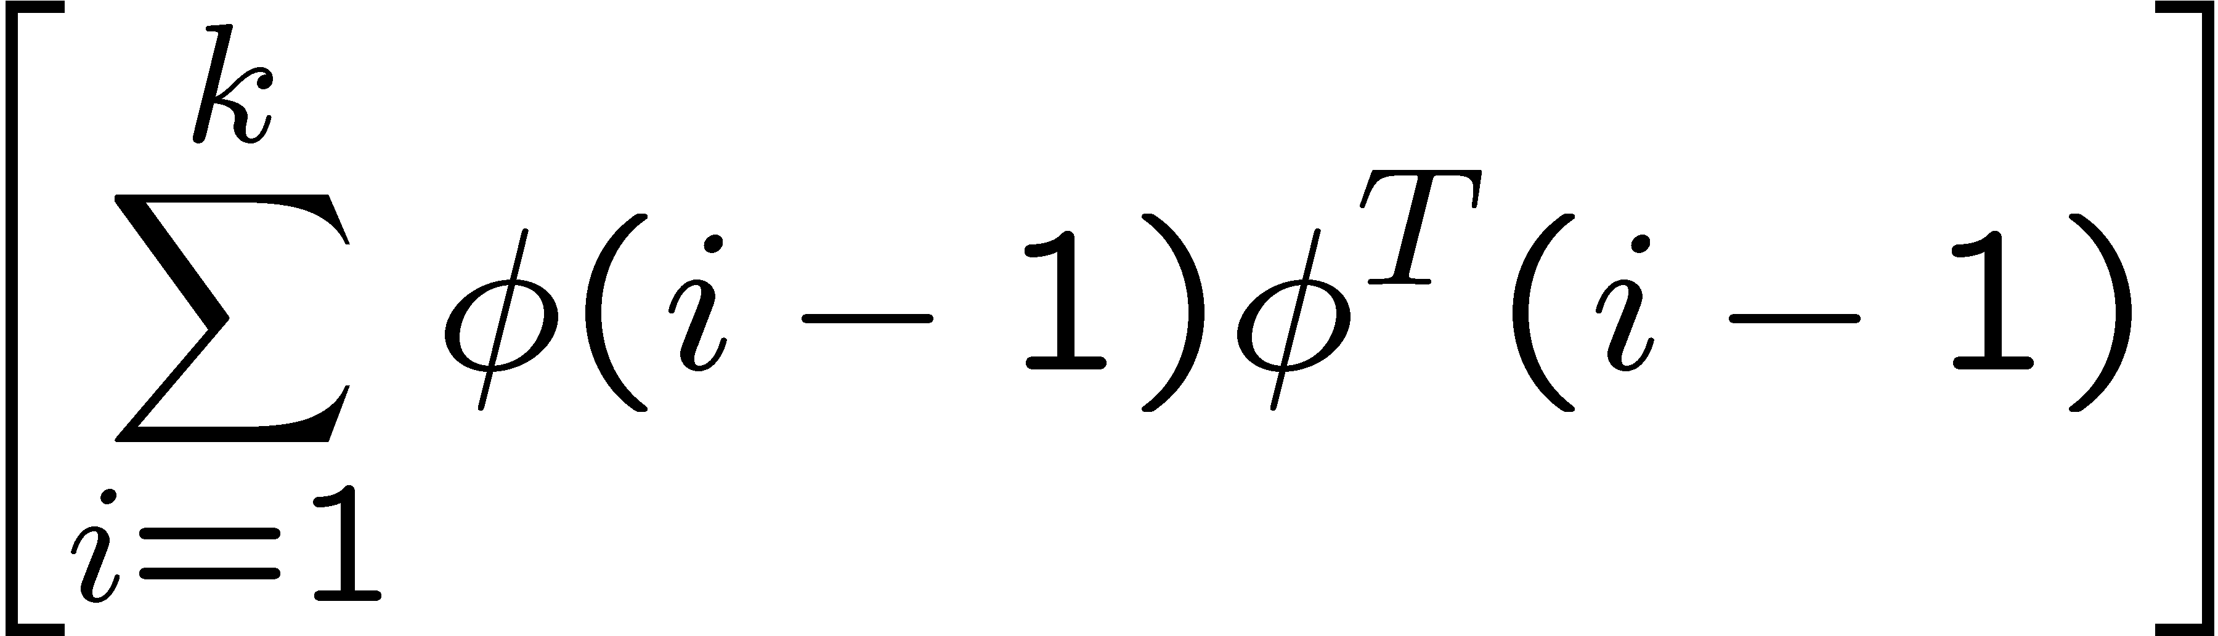
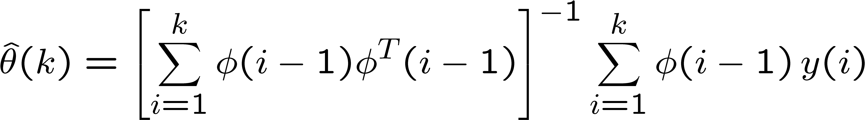

Batch Least Squares Estimation
Assume that we have collected sufficient data
and the data has sufficient richness so that
has full rank.
Then,

Slide 14
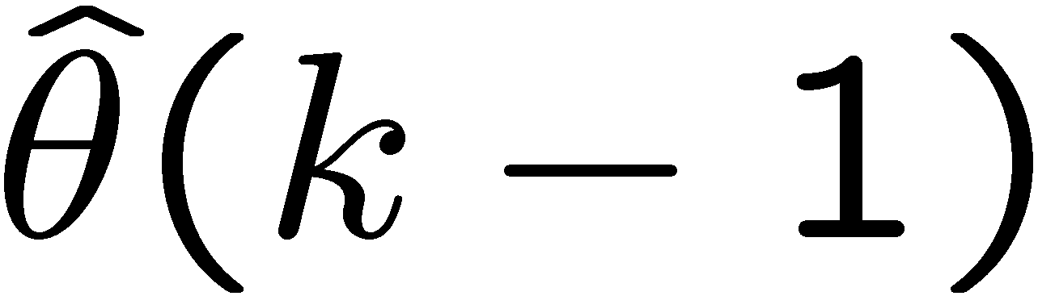
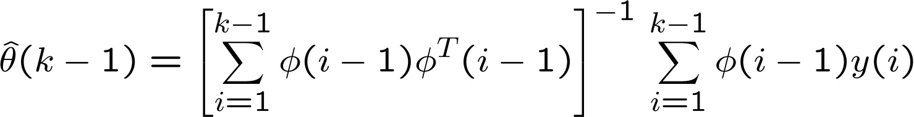


Recursive Least Squares (RLS)
Assume that we have collected k-1 sets of data and have computed using
Then, given a new set of data:
We want to find in a recursive fashion:

Slide 15
Recursive Least Squares Algorithm
Define the a-priori output estimate:
and the a-priori output estimation error:
The RLS algorithm is given by:
where F(k) has the recursive relationship on the next slide

Slide 16
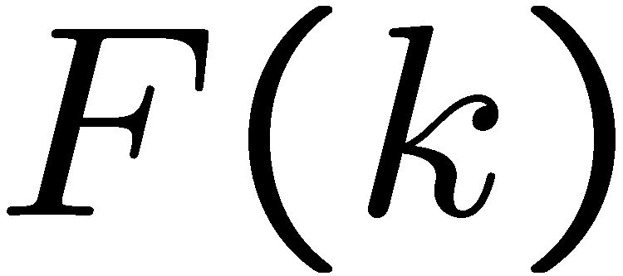
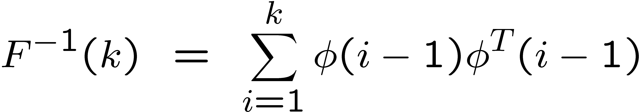
Recursive Least Squares Gain
The RLS gain is defined by
Therefore,
Using the matrix inversion lemma, we obtain

Slide 17
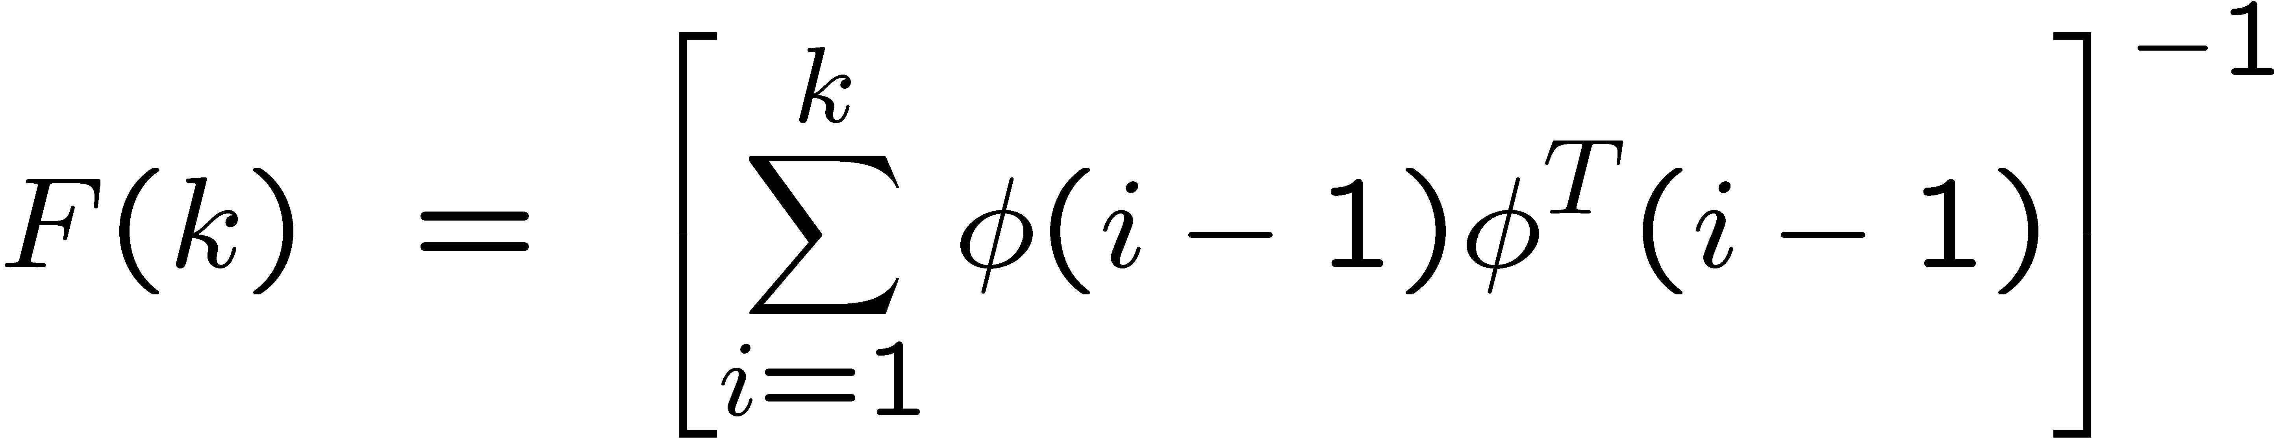
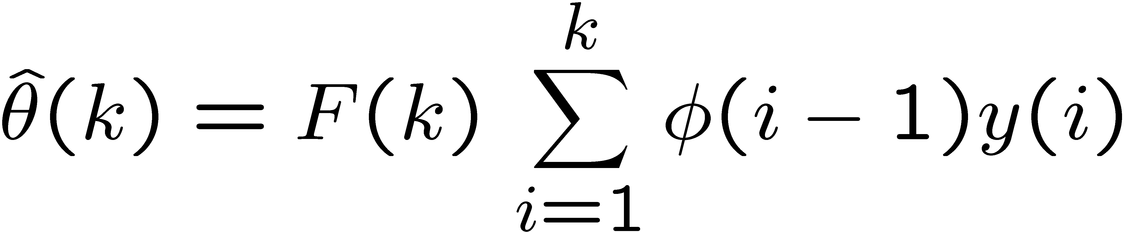
Recursive Least Squares Derivation
Define the least squares gain matrix
Therefore,

Slide 18
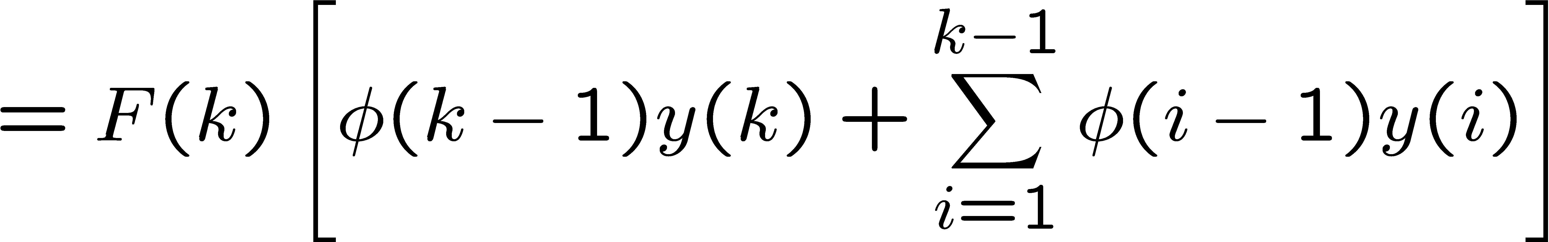
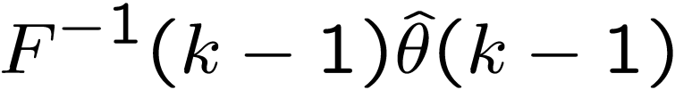
Recursive Least Squares Derivation
Notice that

Slide 19
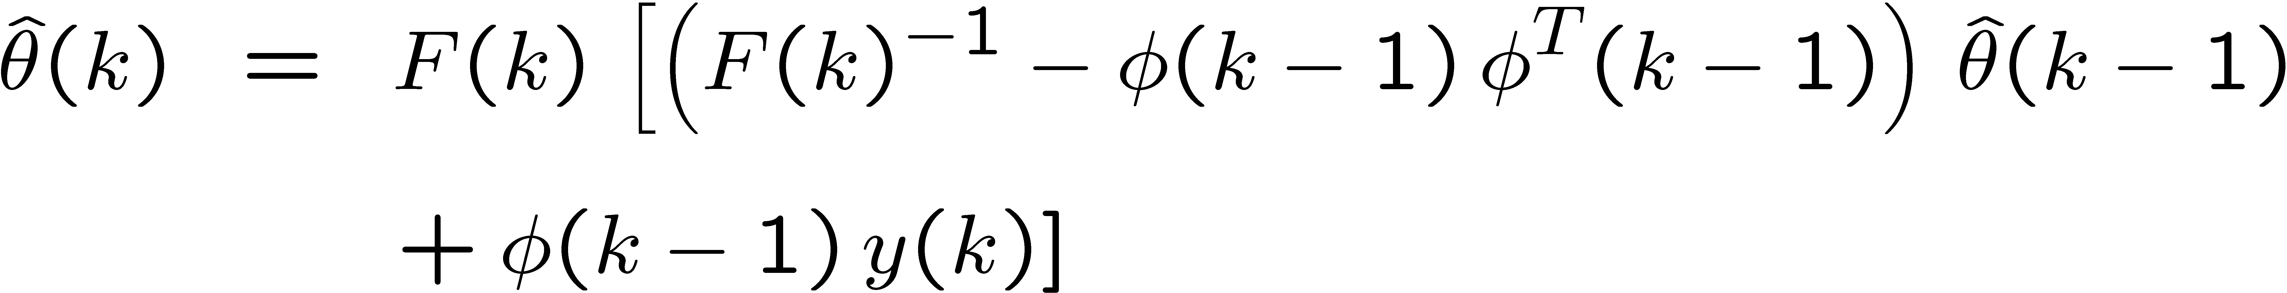
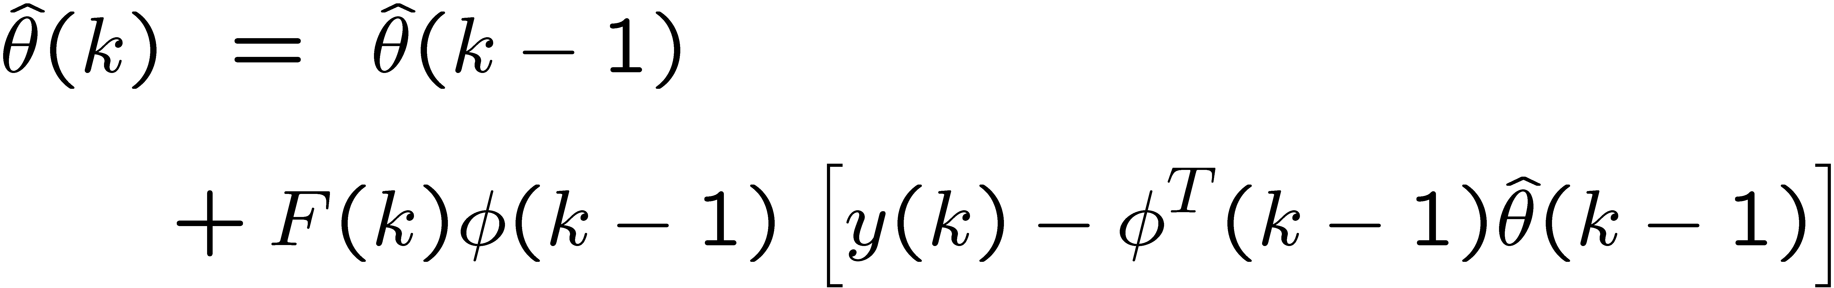

Recursive Least Squares Derivation
Therefore plugging the previous two results,
And rearranging terms, we obtain

Slide 20
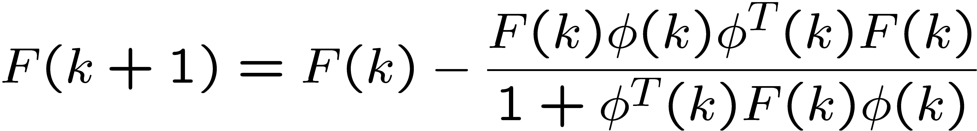
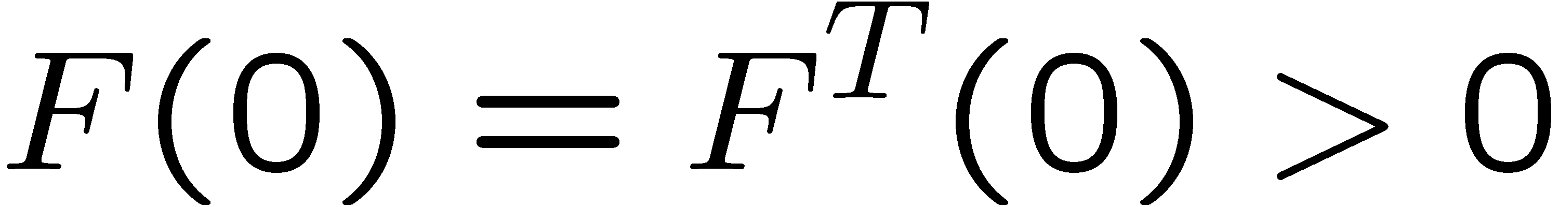
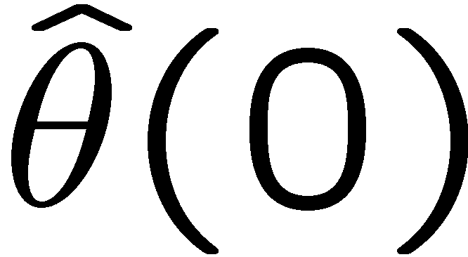
RLS Estimation Algorithm
A-priori version:
Initial conditions:

Slide 21

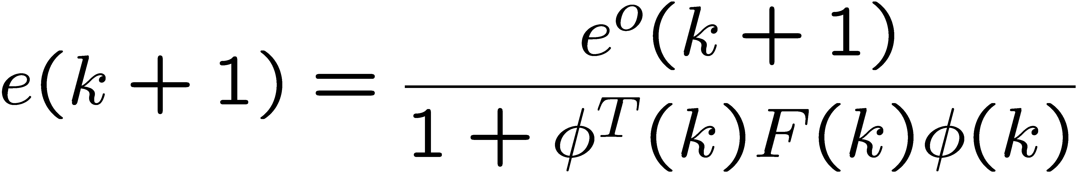
RLS Estimation Algorithm
A-posteriori version (used to prove that ):

Slide 22
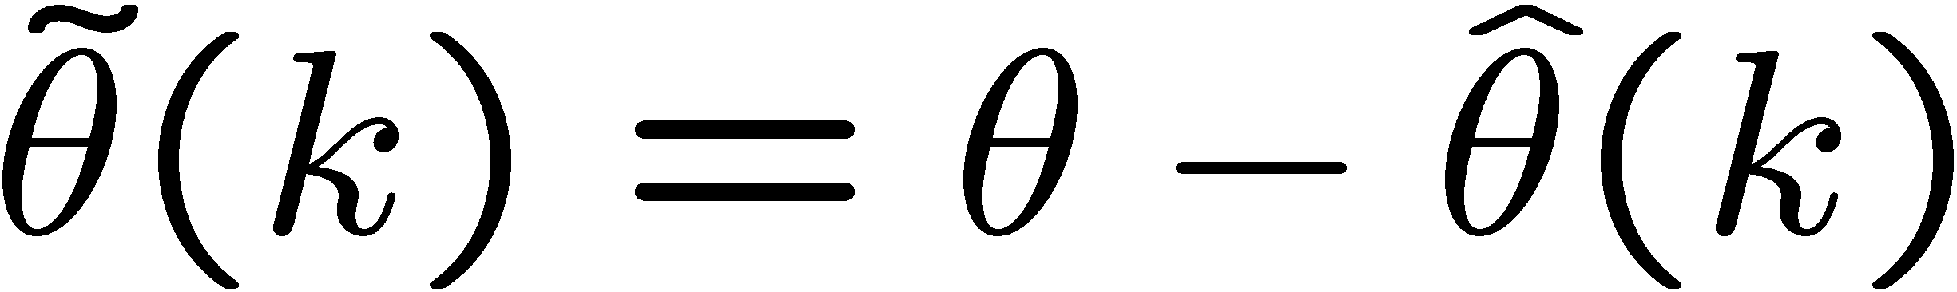
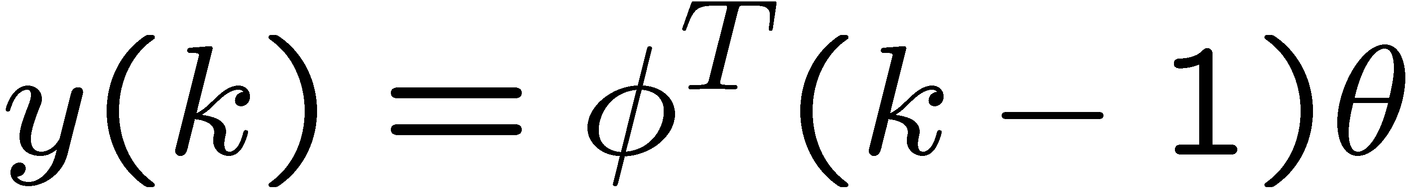
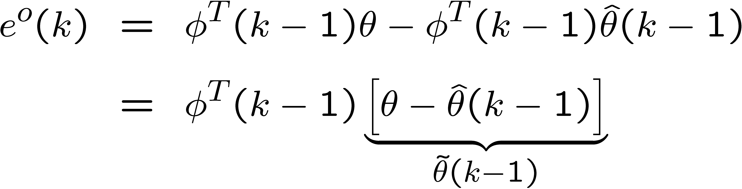
RLS Estimation Algorithm
Define the parameter estimation error:
Notice that, since
And the a-priori error is
We obtain,

Slide 23
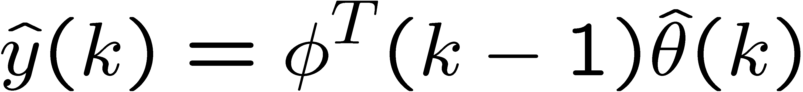
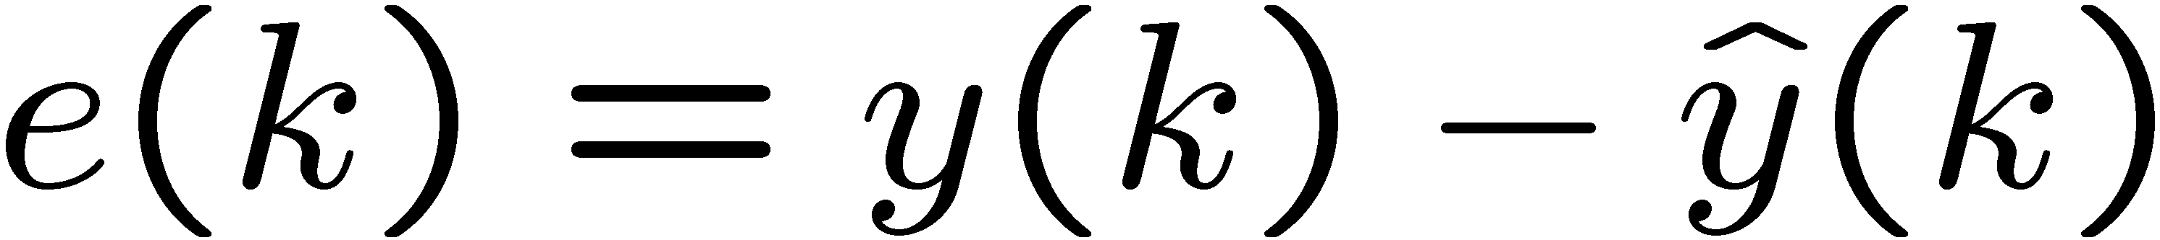
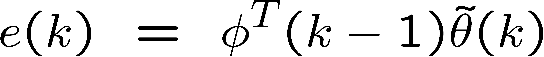
RLS Estimation Algorithm
Thus, the a-priori output estimation error can be written as
Similarly, define the a-posteriori output and estimation error :
then,

Slide 24
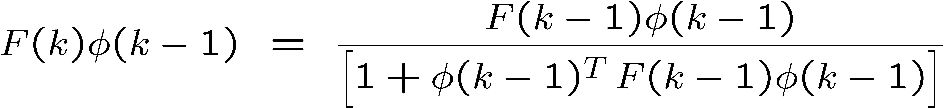
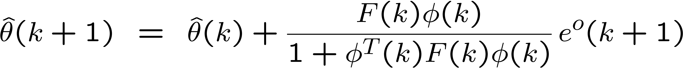
RLS Estimation Algorithm
Derivation of the RLS A-posteriori version:
Remember that,
Thus,

Slide 25
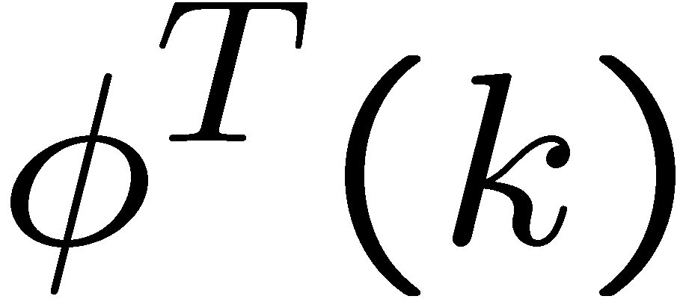



RLS Estimation Algorithm
Multiplying by to the left of
to obtain,
Thus,

Slide 26


RLS Estimation Algorithm
Therefore, from
We obtain,

Slide 27



RLS with forgetting factor
The inverse of the gain matrix in the RLS algorithm is given by:
Its trace is given by:
which always increases when

Slide 28

RLS with forgetting factor
Similarly, the trace of the gain matrix is given by
always decreases when
Problem: RLS eventually stops updating

Slide 29




RLS with forgetting factor
We can modify cost function to “forget” old data
Key idea: Discount old data, e.g. the term
is small when k is large since

Slide 30

RLS with forgetting factor
A-priori version:
Same as RLS without forgetting factor

Slide 31


RLS with forgetting factor
A-posteriori version (used to prove that ):

Slide 32



RLS with forgetting factor
The gain of the RLS with FF may blow up
if is not persistently exciting
(more on this later)

Slide 33


General PAA gain formula
Constant adaptation gain:
RLS:
RLS with forgetting factor:
(We talked about this case in the previous lecture)

Slide 34
General PAA gain formula

Slide 35

General PAA
A-priori version:
When , the parameter estimate equation simplifies to

Slide 36


General PAA
A-posteriori version (used to prove that ):

Slide 37
Additional Material
(you are not responsible for this)
The Matrix Inversion Lemma
Relationships for the General PAA

Slide 38

Matrix Inversion Lemma
(simplified version)
Since , we know that
The matrix inversion lemma (simplified version) states that

Slide 39



Matrix Inversion Lemma
(simplified version)
Proof:
Define
We want to show that

Slide 40


Matrix Inversion Lemma
If A, C, and (A+UCV) are invertible, then
Proof:

Slide 41

Relationships for General PAA
Proof:
We know that
By the Matrix Inversion Lemma
This simplifies to the stated expression for F(k+1)

Slide 42


Relationships for General PAA
Proof:

Slide 43





Relationships for General PAA
Proof:

Slide 44
Relationships for General PAA
Proof (continued):
From the previous slide,

